Slide 1
Linux system administration
done BY
k.Shivani (aiml)
m.Lavanya(ece-3b)
m.manideep(cse-3b)
s.chenna Rao(ece-3c)
m.vivek reddy(ece-3b)

Slide 2
Content:-
Linux system administration
Linux operating system
Components of Linux operating system
Linux Commands

Slide 3

Linux system administration
Linux system administration is a process of setting up, configuring, and managing a computer system in a Linux environment. System administration involves creating a user account, taking reports, performing backup, updating configuration files, documentation, and performing recovery actions. The user who manages the server, fixes configuration issues, recommends new software updates, and updates document is the system administrator.

Slide 4
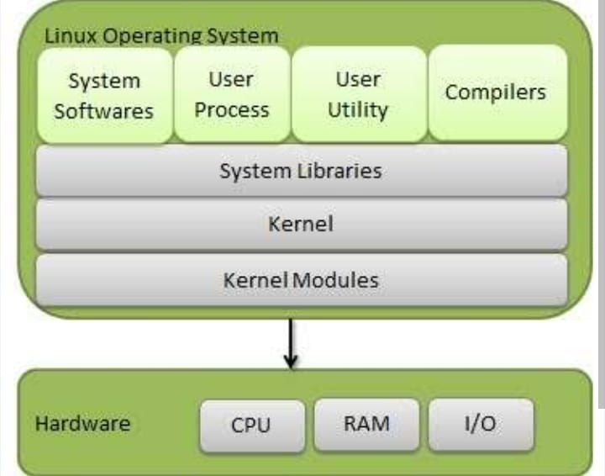
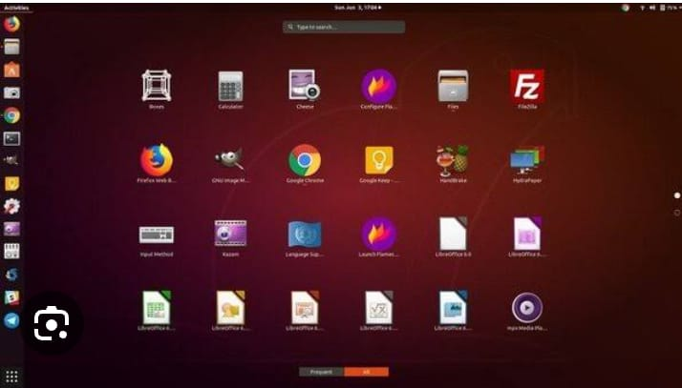
Linux operating system
The Linux operating system was developed by Linus Torvalds in 1991. The Linux operating system is an open-sourced system software that manages the computer hardware resources and computing devices.
The Linux family is called distribution (distro), whereas the Windows operating system is called version.

Slide 5
Components of Linux operating system
The Linux operating system contains the following components:
Bootloader: This is a software that manages the boot process of your computer.
Kernel:The kernel is a computer program at the core of a computer's operating system and generally has complete control over everything in the system.
Init system: This is a subsystem that bootstraps the user space and controls daemons. The init system manages the boot process after it is handled by the bootloader.
Daemons: Daemons are programs or drivers that manage underground applications like printing sounds, network, etc.
Graphical server: The graphical server system supports the graphic display on the screen.

Slide 6
Linux Commands
1. pwd Command
The PWD command is used to display the location of the current working directory.
Syntax:pwd
2. mkdir Command
The mkdir command is used to create a new directory under any directory.
Syntax:mkdir <directory name>

Slide 7
.
3. rmdir Command:The command is used to delete a directory.
Syntax:rmdir <directory name>
4. ls Command
The ls command is used to display a list of content of a directory.

Slide 8
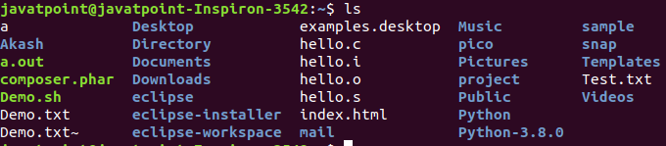
.
Syntax:
ls
_{5. cd Command}
The cdcommand is used to change the current directory.
_{Syntax:}
_{cd <directory name>}

Slide 9


.
6. touch Command
The touch command is used to create empty files. We can create multiple empty files by executing it once.
Syntax:
touch <file name>
2.touch <file1> <file2> .
7. cat Command
The cat command is a multi-purpose utility in the Linux system. It can be used to create a file, display content of the file, copy the content of one file to another file, and more.
Syntax:
cat [OPTION]... [FILE]
To create a file, execute it as follows:
cat > <file name>

Slide 10
.
8. rm Command
The rm command is used to remove a file.
Syntax:
rm <file name>
9. cp Command
The cp command is used to copy a file or directory.
Syntax:
To copy in the same directory:
cp <existing file name> <new file name>

Slide 11
.
10. mv Command
The mv command is used to move a file or a directory form one location to another location.
Syntax:
mv <file name> <directory path>

Slide 12
Thank you

